Slide 1


Composites
Luis Enrique Montoya Mota
Mat: 1663634 Group: 013
Teacher: Dra. Bindu Krishnan

Slide 2
Composites: It is composed of at least to materials, which usually posses properties that are very different from each other.
It is formed of two parts or phases, one of them is the matrix, and the other is called the reinforcement.

Slide 3
Matrix
It is the binder that holds together the fibers or fragments of the other material
Reinforcement
It if embedded into the matrix
It is the monolithic material
It is used to change physical properties like thermal conductivity, friction coefficient , electricity conductivity or wear resistance
It may be present in the form of particles or fibers.

Slide 4
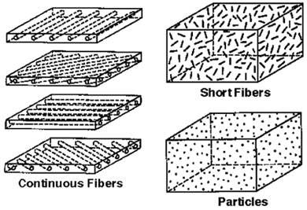
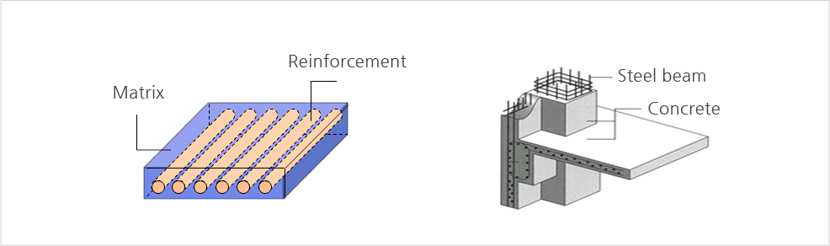
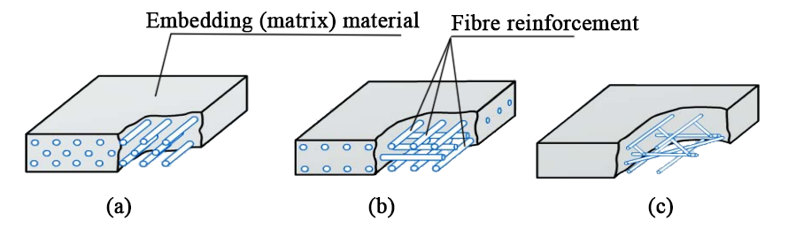

Slide 5
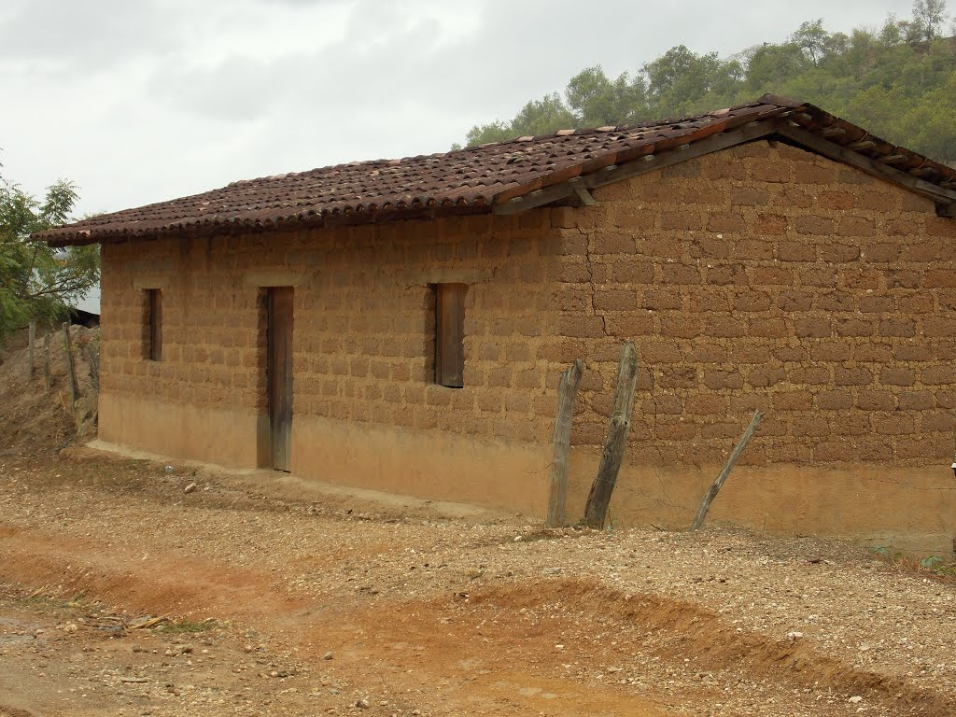
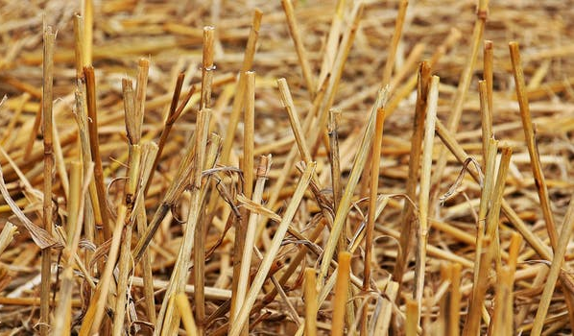
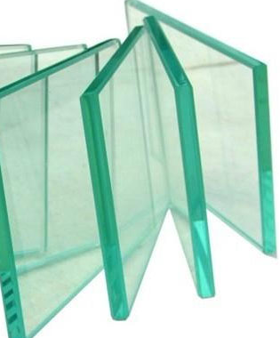
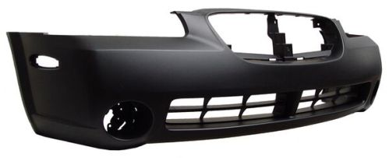
Mud Bricks
Dry Mud (Matrix): Hard and brittle, strong when under
compression, but breaks easily if you try to bend it.
(Poor tensile strength)
Straw (Reinforcement): Strong if you try to stretch it but
very flexible (Hight tensile strength)
Fiberglass (Glass reinforced plastic)
Plastic (Matrix):Polymer
Soda-Lime Glass
(Reinforcement) Ceramic

Slide 6
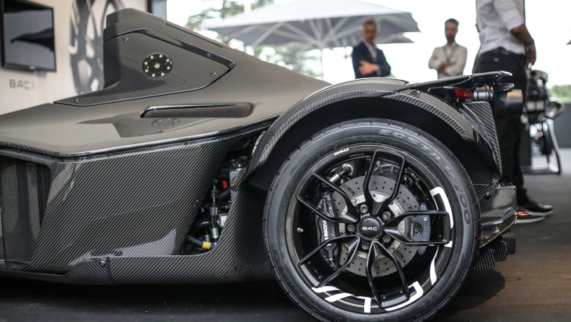
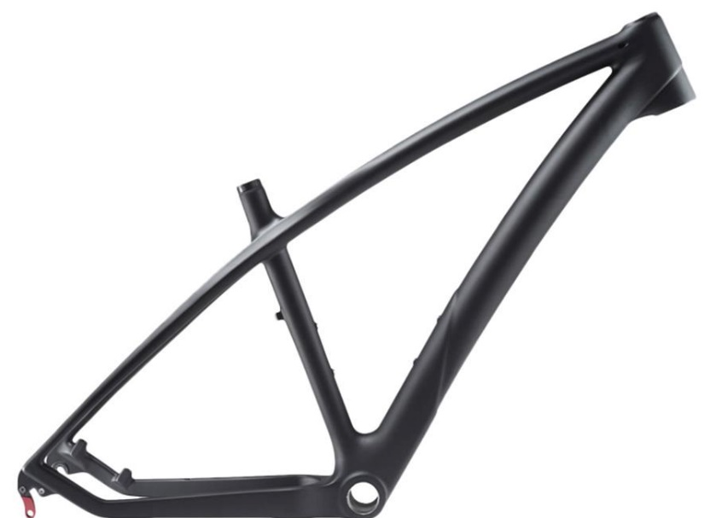
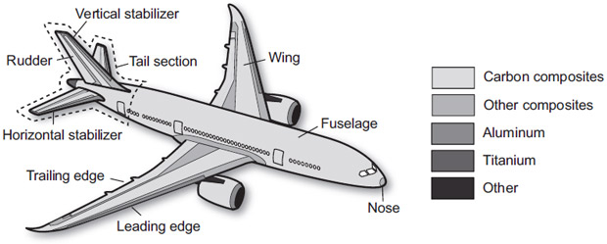
Why composites?
Weight reducing
Increasing stiffness and strength
Electrical or thermal insulation
The global composites material market is growing about 5% per year

Slide 7
Classification
Composites
Matrix Based
Reinforcement Based
Fibrous Composites
Particulate Composites
Metal Matrix
Short Fiber (Whiskers)
Ceramic Matrix
Polymer Matrix
Continuous Fibers

Slide 8
Metal Matrix
The most important MMC systems are:
Aluminum matrix
  Continuous fibers: boron, silicon carbide, alumina, graphite
  Whiskers: silicon carbide
  Particles: silicon carbide, boron carbide
Magnesium matrix
  Continuous fibers: graphite, alumina
  Whiskers: silicon carbide
  Particles: silicon carbide, boron carbide
Titanium matrix
  Continuous fibers: silicon carbide, coated boron
  Particles: titanium carbide
Copper matrix
  Continuous fibers: graphite, silicon carbide
  Particles: silicon carbide, boron carbide, titanium carbide.
MMC´s are made by dispersing reinforcing material into a metal matrix. The reinforcement surface may be coated to prevent chemical reactions.

Slide 9
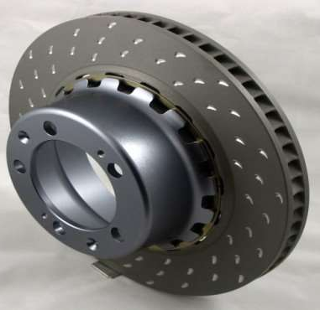
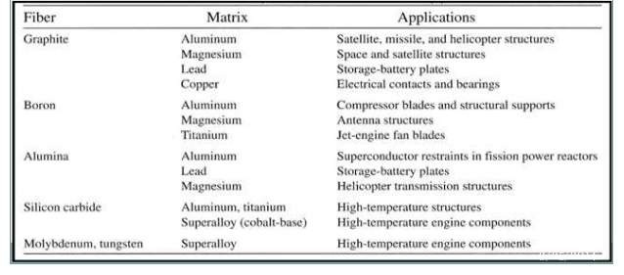
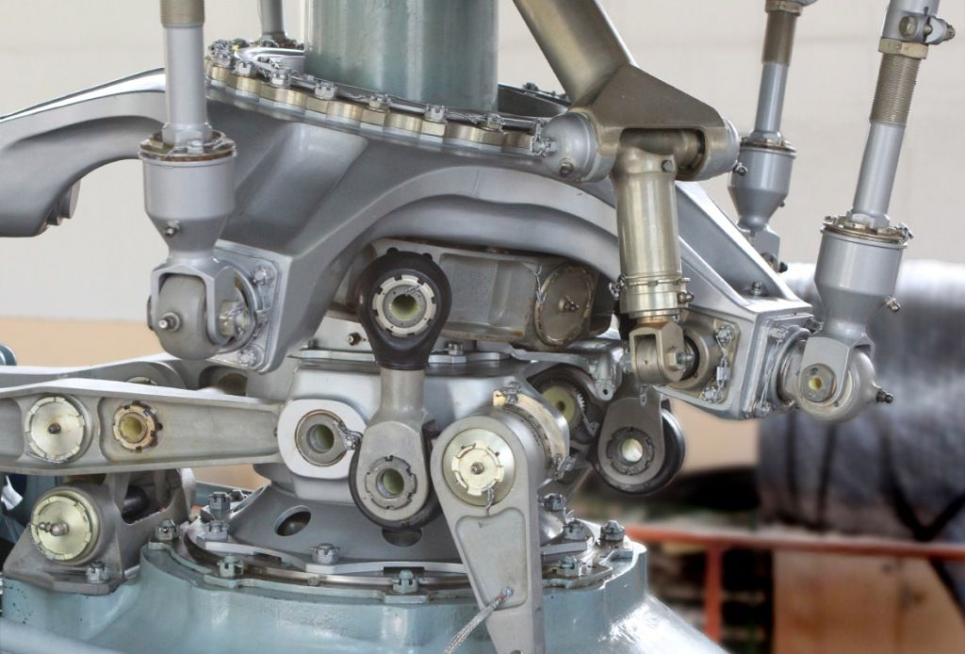
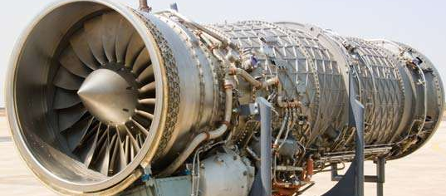
Applications

Slide 10
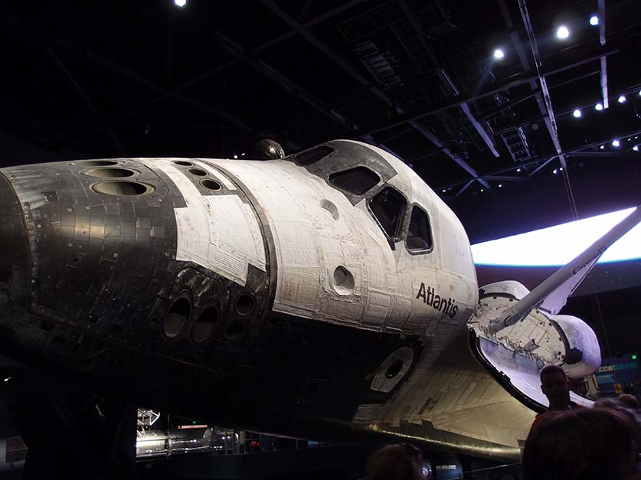
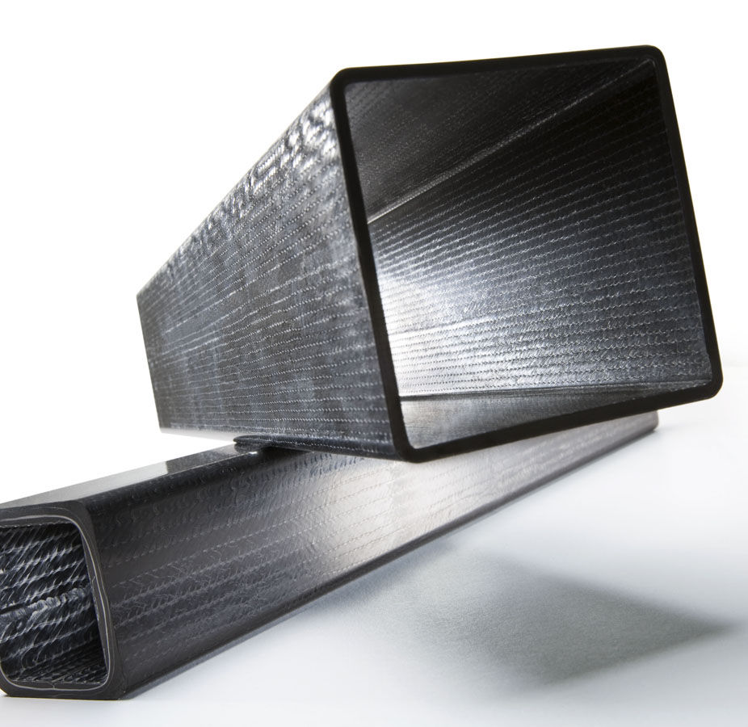
Ceramic Matrix
Examples:
Silicon Nitride (Si3N4) Matrix with Silicone Carbide (SiC) Particles
Alumina (Al2O3) Matrix with Silicon Carbide Short Fibers
Carbon-Carbon Composites (Carbon Fibers reinforcing Graphite matrix)
CMC´s are composed of a ceramic matrix reinforced with ceramic fibers, either long or short (continuous or discontinuous)

Slide 11
Polymer Matrix
Kevlar: Kevlar® is a material formed by combining para-phenylenediamine and terephthaloyl chloride. It forms a filament that is layered up and woven with resin to shape it up.
Fiberglass
Carbon Fiber: It if made out of really thin filaments of carbon twisted together like yarn and netted to make a fabric, the it is molded and coated in the polymer to give it a permanent shape.
PMC´s consist in a polymer matrix dispersed with a fibrous reinforcement.
Popular due to their low cost and simple fabrication methods.
The most widely used form is laminar structure (layers of fiber and polymer until desired thickness is reached), also spraying up which is the process where liquid polymer matrix and chopped reinforcing fibers are sprayed out of two separate spays in the mold surface.

Slide 12
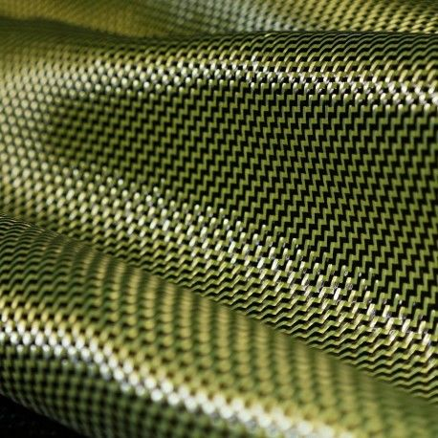
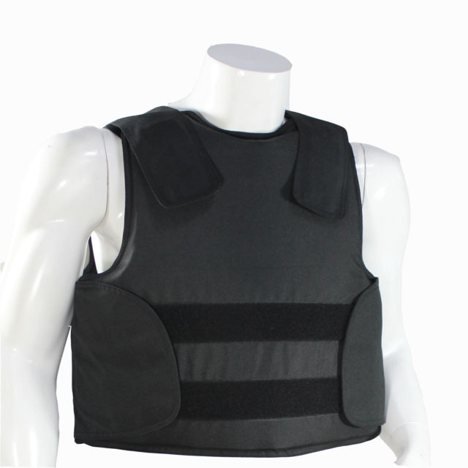

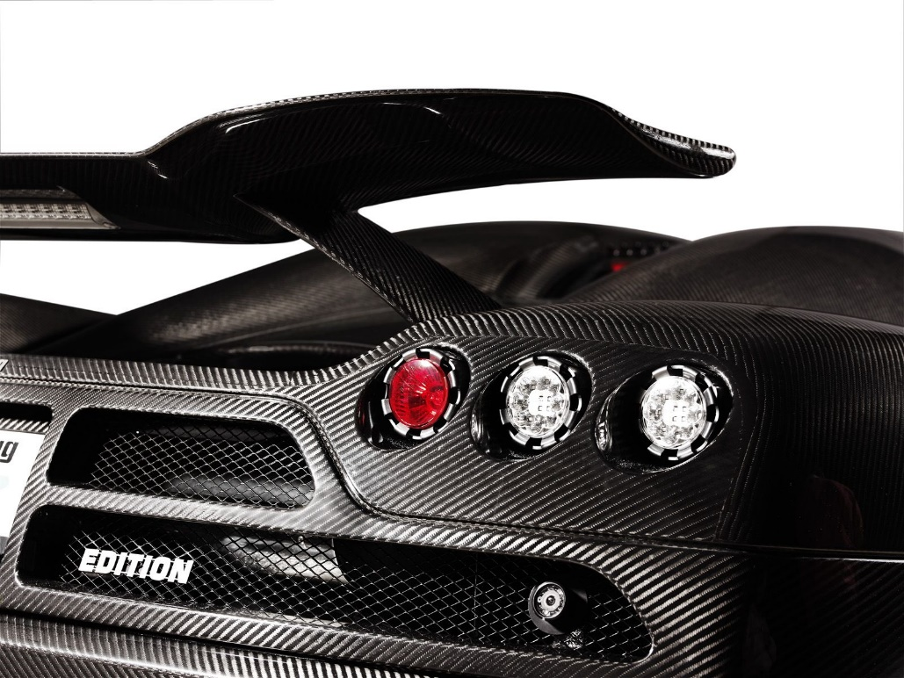

Slide 13
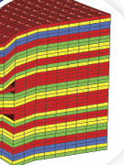
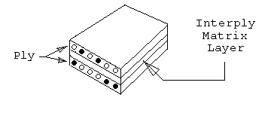
Hybrids
When two or more fibers materials are combined in the composite
Intraply hybrids (within) - Alternate strands of different fibers in a single layer or ply
Interply hybrid (across) – Different plies of different fibers

Slide 14
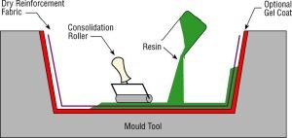
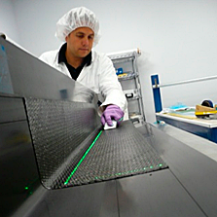
Manufacturing processes
Manufacturing processes vary depending on the specific parts or objects that are going to be created
Open Molding (Mainly Short fibers)
In open molding, raw materials (resins and fiber reinforcements) are exposed to air as they cure or harden. Open molding utilizes different processes, including hand lay-up, spray-up, casting, and filament winding.

Slide 15
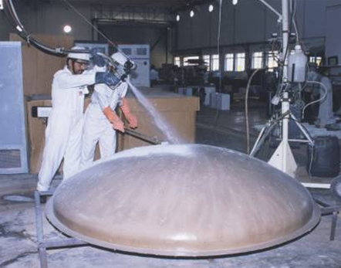
Hand Layup
Consists of laying dry fabric layers, or “plies,” made out of the long fibers that will be the reinforcement, by hand unto a tool to form a laminate stack. Resin is applied to the dry plies after layup is complete, commonly used with epoxy, vinyl ester and polyester matrix.
Spray Up
Similar to hand lay-up, spray-up offers greater shape complexity and faster production. Spray-up utilizes a low-cost open mold, room temperature curing resin, and is ideal for producing large parts such as tub/shower units and vent hoods in low to moderate quantities. Chopped fiber reinforcement and resin are deposited in the mold from a chopper/spray gun.
As with lay-up, manual rolling removes entrapped air and wets the fiber reinforcement. Woven roving is often added in specific areas for thickness or greater strength. Pigmented gel coats can be used to produce a smooth, colorful surface.

Slide 16
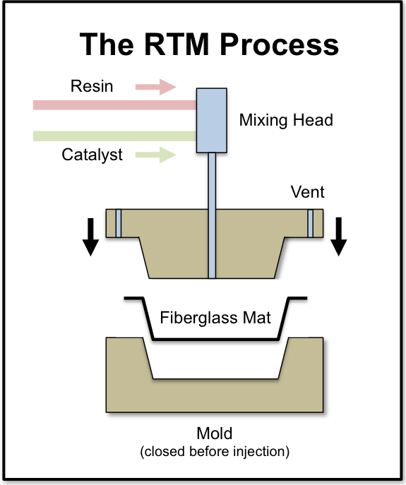
Resin Transfer Molding
Also referred to as liquid molding. RTM is a fairly simple process: It begins with a two-part, matched, closed mold that is made of metal or composite material. Dry reinforcement is placed into the mold and the mold is closed. Resin and catalyst are metered and mixed in dispensing equipment, then pumped into the mold under low to moderate pressure through injection ports, following predesigned paths through the preform. Extremely low-viscosity resin is used in RTM applications for thick parts to permeate preforms quickly and evenly before cure

Slide 17
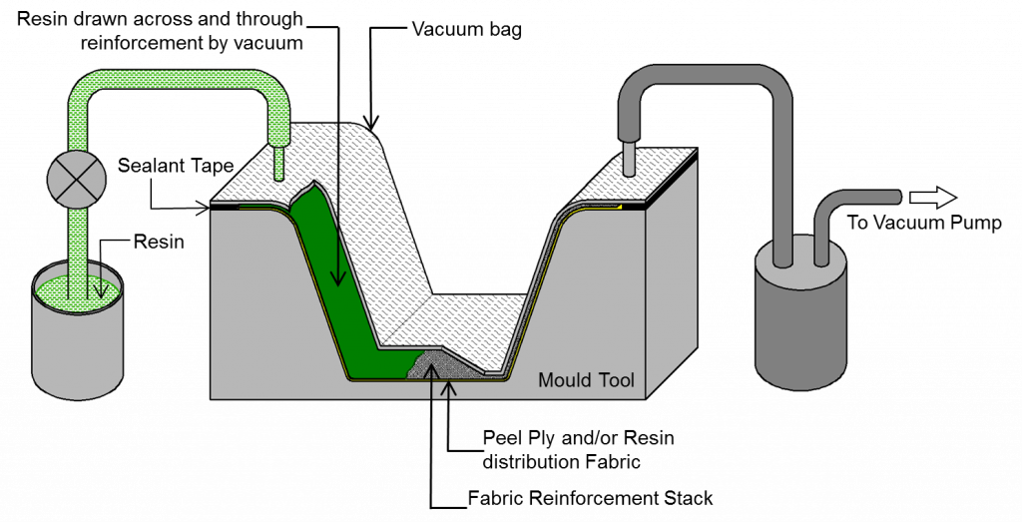
Vacuum Assisted Resin
Transfer Molding
Vacuum-assisted resin transfer molding (VARTM) refers to a variety of related processes that represent the fastest-growing new molding technology. The salient difference between VARTM-type processes and RTM is that in VARTM, resin is drawn into a preform through use of a vacuum only, rather than pumped in under pressure. VARTM does not require high heat or pressure. For that reason, VARTM operates with low-cost tooling, making it possible to inexpensively produce large, complex parts in one shot.

Slide 18
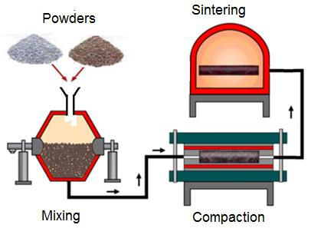
Powder Metallurgy Method (Particles)
It is the mixing of the powders to form components by compressing it.
Used for metal matrix composites reinforced with small particles.
The powder metallurgy process generally consists of four basic steps: powder manufacture, powder blending, compacting, and sintering.

Slide 19
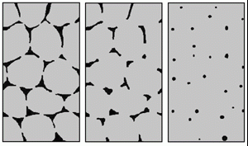
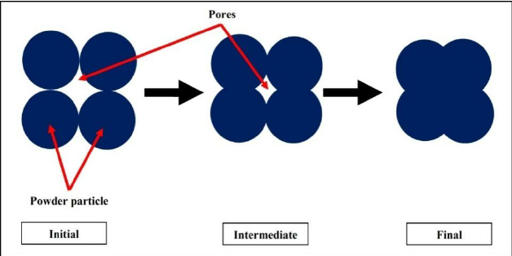
Sintering
Sintering is the process of taking metal in the form of a powder and placing it into a mold. Once compacted into the mold the material is placed under a high heat for a long period of time. Under heat, bonding takes place between the porous aggregate particles and once cooled the powder has bonded to form a solid piece. One technique for high-speed sintering involves passing high electrical current through a powder to preferentially heat the asperities.

Slide 20
Sources
“Polymer Matrix Composites and Technology” by Ru-Ming Wang, Shui-Rong Zheng and Ya-Ping Zheng
www.elsevier.com
www.zoltek.com
www.substech.com
www.phelpsgaskets.com
www.compositesuk.co.uk
www.machinedesign.com
www.eaglealloys.com
www.rsc.org
www.technologystudent.com

